Slide 1
Module 4 plan procurement management – inputs, Tools, techniques
Mgmt 6063 – Project Procurement
To do – in-class make/buy exercise sheet

Slide 2

Module agenda
Module Learning Outcomes
Understand use of inputs, tools, techniques in planning procurement management
Evaluate advantages and disadvantages for both the make and buy decisions
Calculate and compare costs for the make-or-buy decision
Determine preferred approach for source selection
Homework/evaluations
Notes:
Image https://www.sandler.com
Apply categories .....
Understand the advantages ...
Use of Function Points ...
Work with 3-point estimates,...
Discern the various reasons ...
Calculate ...
Develop ...
Evaluate ...
Extract ...
Recognize ...

Slide 3
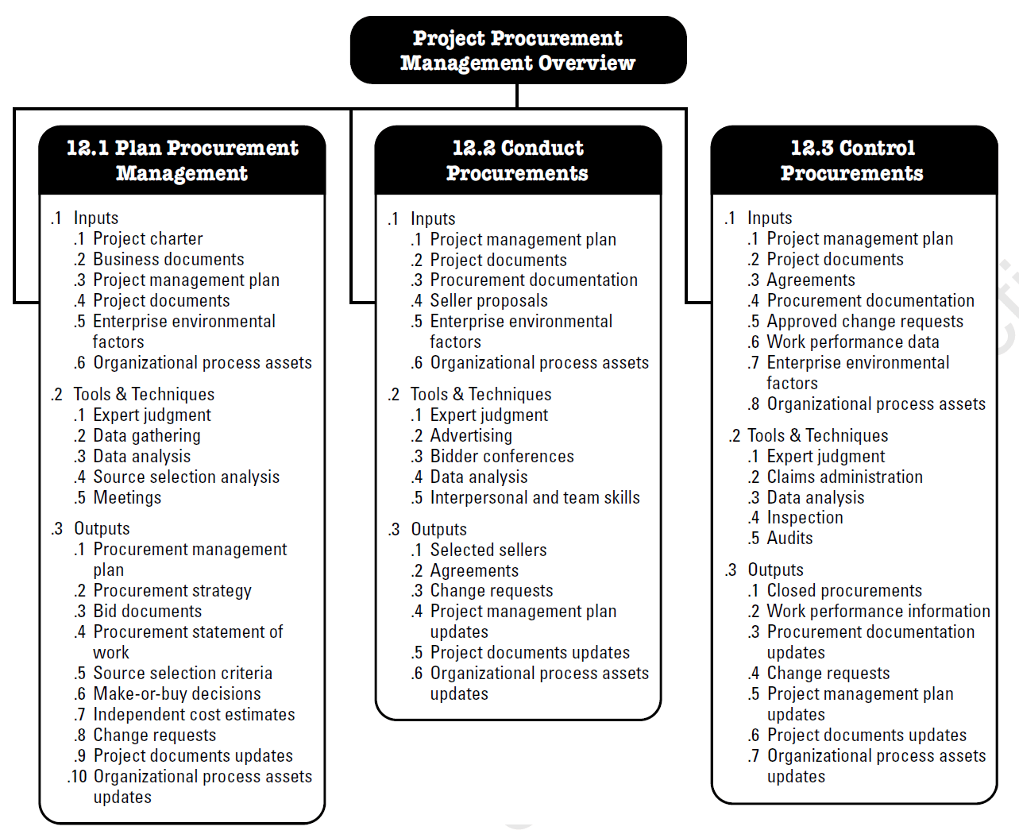
Project procurement management plan procurement management
Plan Procurement Management The process of documenting project procurement decisions, specifying the approach, and identifying potential sellers.
Notes:
Image - Project Management Institute, Inc., PMBOK Guide 6th Edition (2017)

Slide 4
Project procurement management plan procurement management
Objectives
Determine whether or not to acquire goods and services from outside the project (organization).
What to acquire as well as how and when to acquire.
Notes:
Image - Project Management Institute, Inc., PMBOK Guide 6th Edition (2017)

Slide 5
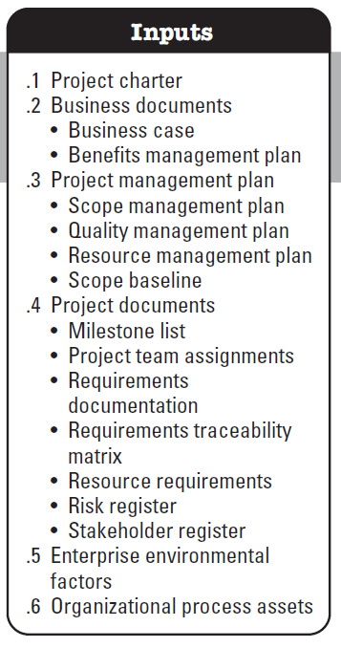
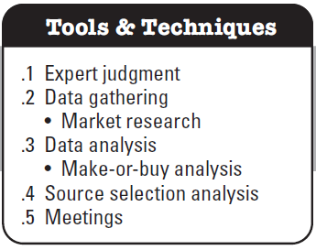

plan procurement management – inputs, T&T
Reminder:
lists within lists
PMBOK tools and techniques are summarized in PMBOK Appendix X6
Notes:
Image - Project Management Institute, Inc., PMBOK Guide 6th Edition (2017)

Slide 6
plan procurement management inputs
Benefits management plan – What specific project benefits are expected? Will drive procurement dates and contract language/approach.
Quality management plan – Applicable standards/requirements will carry over into bidding documents.
Resource management plan – Has information on which resources will be purchased or leased.
Risk register – Some risk may be transferred (to other parties) through a procurement contract.
Several scope-related inputs to stress the importance of understanding the project scope and requirements.
Notes:
Image - Project Management Institute, Inc., PMBOK Guide 6th Edition (2017)

Slide 7
plan procurement management inputs (cont’d)
Enterprise environmental factors are internal or external conditions that influence, constrain or direct the project. A sampling related to procurement:
Marketplace conditions and services/product that are available
Sellers – availability, reputation, performance
Unique local requirements (e.g., regulatory)
Legal advice/direction
Established supplier systems (consider multi-tier automotive supplier system)
Financial and contract payment systems
Notes:
Image - Project Management Institute, Inc., PMBOK Guide 6th Edition (2017)

Slide 8
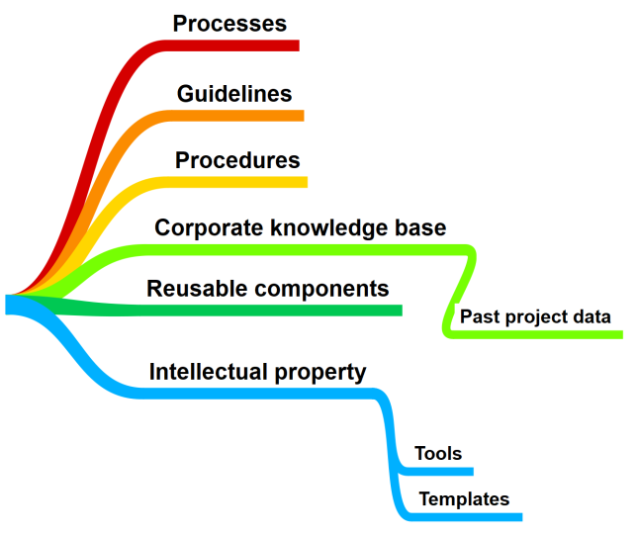
plan procurement management inputs (cont’d)
Organizational process assets
A sampling of OPA related to procurement:
Preapproved sellers list
Formal/required procurement policies, procedures and guidelines
Contract types/format/templates
Notes:
Image - Project Management Institute, Inc., PMBOK Guide 6th Edition (2017)
Image https://mindmapdictionary.wordpress.com/

Slide 9
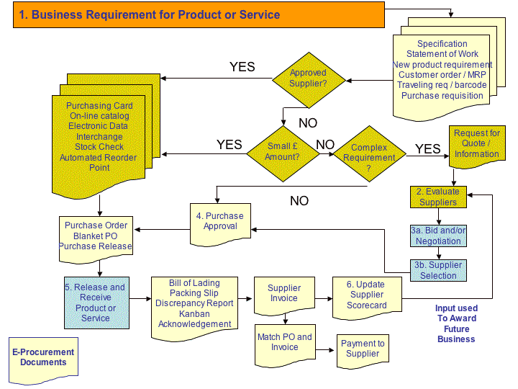
Organization process assets - example
Procurement procedure includes criteria related to:
Approved suppliers
Value of work
Complexity
Type of contract
Documentation requirements
Notes:
Image - https://scm.ncsu.edu/scm-articles/article/the-procurement-process-creating-a-sourcing-plan-procurement-a-tutorial

Slide 10

Organization process assets - contracts
Most organizations have preferred contract types/formats/templates that have been vetted through legal advice.
Main contract types (you may recall these from other project courses such as MGMT 6054 or MGMT 6056):
Fixed-price
Cost-reimbursable
Time and material
We will explore contracts in depth in a future module
Notes:
Image - https://en.wikipedia.org

Slide 11
plan procurement management tools & techniques
Expert judgement - IMPORTANT
Engage the procurement manager/specialist in your organization
Market research – Investigate industry and specific seller capabilities and resources.
Make-or-buy analysis – Determine whether work or deliverables can best be accomplished by the project team (within your organization) or should be purchased from outside sources. Methods of analysis: payback period, return on investment (ROI), internal rate of return (IRR), net present value (NPV), benefit/cost analysis.
Notes:
Image - Project Management Institute, Inc., PMBOK Guide 6th Edition (2017)

Slide 12
Make-or-buy analysis
Reasons for make/buy decisions:
Make | Buy
Less costly (but not always!) Easy integration of operation Utilize existing capacity that is idle Maintain direct control Maintain design/production secrecy Avoid unreliable supplier base Stabilize existing workforce | Less costly (but not always!) Utilize skills of suppliers Small volume requirement (not cost effective to produce) Having limited capacity or capability Augment existing work force Maintain multiple sources (qualified vendor list) Indirect control

Slide 13
Make-or-buy analysis
Factors to consider:
Relevant costs considering direct and indirect costs
Contract types (cost, risk)
When do you need the goods/services? Short term need?
Do you have qualified staff? If not, is there time to become qualified? Some staff are more qualified than others
Are there outside suppliers with available skill and capacity?
What rules and/or regulations do you need to consider/observe?
Quality of product or service
Strategic vs. tactical
Business, competitive advantage?

Slide 14
Make-or-buy analysis
Cost factors:
Make | Buy
Variable cost per unit Fixed cost Storage/warehousing Purchasing, operations, managerial expenses | Transportation Purchase Support
Ask the accounting/finance specialists in your organization about what should be included.

Slide 15

make-or-buy analysis cost analysis scenario
Image https://www.canadiantire.ca/en/pdp/disney-star-wars-the-mandalorian-baby-yoda-8-in-plush-toy-for-kids-ages-4-0502168p.0502168.html?gclid=CjwKCAiAksyNBhAPEiwAlDBeLL7clnWYQASfcVyjov46tkTbPJ5-V-miykzwKnpxEiDZGieDFOpNURoCypQQAvD_BwE&gclsrc=aw.ds#store=208
Our project requires 150,000 Baby Yoda figurines. We have the equipment/capacity to make them but could also buy them (and with same quality). We must consider variable and fixed costs, as well as opportunity cost.
What is an opportunity cost? It’s the loss of a potential gain from other actions we could have done instead of the alternative we chose.
So when we decided to choose to “make” our Baby Yoda, we had to use labour. And by using labour for our Baby Yoda, we lost the opportunity to make a different product. Assuming making this other product was profitable, we lost the opportunity for this gain.
Notes:
Image https://www.canadiantire.ca/en/pdp/disney-star-wars-the-mandalorian-baby-yoda-8-in-plush-toy-for-kids-ages-4-0502168p.0502168.html?gclid=CjwKCAiAksyNBhAPEiwAlDBeLL7clnWYQASfcVyjov46tkTbPJ5-V-miykzwKnpxEiDZGieDFOpNURoCypQQAvD_BwE&gclsrc=aw.ds#store=208

Slide 16
make-or-buy analysis cost analysis scenario
Image https://www.canadiantire.ca/en/pdp/disney-star-wars-the-mandalorian-baby-yoda-8-in-plush-toy-for-kids-ages-4-0502168p.0502168.html?gclid=CjwKCAiAksyNBhAPEiwAlDBeLL7clnWYQASfcVyjov46tkTbPJ5-V-miykzwKnpxEiDZGieDFOpNURoCypQQAvD_BwE&gclsrc=aw.ds#store=208
Our project requires 150,000 Baby Yoda figurines. We have the equipment/capacity to make them but could also buy them (and with same quality). We must consider variable and fixed costs, as well as opportunity cost.
Notes:
Image https://www.canadiantire.ca/en/pdp/disney-star-wars-the-mandalorian-baby-yoda-8-in-plush-toy-for-kids-ages-4-0502168p.0502168.html?gclid=CjwKCAiAksyNBhAPEiwAlDBeLL7clnWYQASfcVyjov46tkTbPJ5-V-miykzwKnpxEiDZGieDFOpNURoCypQQAvD_BwE&gclsrc=aw.ds#store=208

Slide 17

make-or-buy analysis Rent/lease breakeven analysis
It’s common to use a Breakeven Analysis when deciding on whether or not you should make or buy a product. This decision typically depends on the quantity of the product you need.
But we can use a breakeven analysis to decide on whether or not we should rent or lease a piece of equipment. In this simple scenario, the decision depends on how long we need the piece of equipment. We can rent the equipment at $100/day OR lease it at $60/day plus a fixed cost of $5,000.
What is the breakeven point in days? i.e. where leasing and renting cost are the same?
Notes:
Image https://www.facebook.com/royequipmentrental/

Slide 18
make-or-buy analysis Rent/lease breakeven analysis
We can rent equipment at $100/day OR lease at $60/day plus a fixed cost of $5,000. What is the breakeven point, in days, where leasing and renting cost are the same?
Set up an equation setting the rental costs equal to lease costs
Let Z = number of days we are renting or leasing
Renting cost = $100 per day x Z days
Leasing cost = $5000 (fixed) + $60 per day x Z days
Make the 2 equations equal to each other
100Z = 5000 + 60Z
We want all the Z’s on one side of the equation and a positive number
100Z – 60Z = 5000 which we can write as 40Z = 5000
Divide both sides by 40 so we have a single Z on one side of the equation
40Z/40 = 5000/40 or Z = 5000/40 or Z = 125 days
Therefore, 125 days is the breakeven point, the rent cost equals the lease cost.
If you consider 126 days, we would have to pay $100 more to rent, but if we lease only $60 more. So it’s better to lease if we need more than 125 days.
Notes:
Image https://www.facebook.com/royequipmentrental/

Slide 19
Make-or-buy analysis Exercises
Handout or Word doc
The Make or Buy Exercise has 3 questions to be answered including numeric calculations as well as Qualitative Factors
M4 - Make or Buy Analysis Exercise.docx

Slide 20
A Retail breakeven
Although usually not associated with procurement, the term breakeven is frequently used in retail and other scenarios.
A simple example. We have a special opportunity to buy 90 special PC keyboards for $1,200 from a wholesale clearance outlet. We think because of the unique design and function of the keyboard that we can sell them online for $20 each.
How many do we have to sell to breakeven on our costs? We want to know this just in case we can’t sell all 90 of them. We need to set up an equation where the revenue equals our $1,200 cost.
Let #KB = number of keyboards we sell
$20 x #KB = $1,200 or 20 #KB = $1,200 or #KB = $1,200/20 = 60 keyboards
So we only have to sell 60 keyboards, not 90, to “cover” our $1,200 investment. Or another way of looking at it is we only start to make money on our investment when we sell the 61st keyboard.

Slide 21
plan procurement management tools & techniques (cont’d)
Source selection analysis – What approach will be taken to acquire/select the service/product supplier?
Least cost
Qualifications only
Quality-based/highest technical proposal score
Quality and cost-based
Sole source
Fixed budget
Or a combination of these.
See Slide Notes
Notes:
Image - Project Management Institute, Inc., PMBOK Guide 6th Edition (2017)
Least cost. The least cost method may be appropriate for procurements of a standard or routine nature where well-established practices and standards exist and from which a specific and well-defined outcome is expected, which can be executed at different costs.
Qualifications only. The qualifications only selection method applies when the time and cost of a full selection process would not make sense because the value of the procurement is relatively small. The buyer establishes a short list and selects the bidder with the best credibility, qualifications, experience, expertise, areas of specialization, and references.
Quality-based/highest technical proposal score. The selected firm is asked to submit a proposal with both technical and cost details and is then invited to negotiate the contract if the technical proposal proves acceptable. Using this method, technical proposals are first evaluated based on the quality of the technical solution offered. The seller who submitted the highest-ranked technical proposal is selected if their financial proposal can be negotiated and accepted.
Quality and cost-based. The quality and cost-based method allows cost to be included as a factor in the seller selection process. In general, when risk and/or uncertainty are greater for the project, quality should be a key element when compared to cost.
Sole source. The buyer asks a specific seller to prepare technical and financial proposals, which are then negotiated. Since there is no competition, this method is acceptable only when properly justified and should be viewed as an exception.
Fixed budget. The fixed-budget method requires disclosing the available budget to invited sellers in the RFP and selecting the highest-ranking technical proposal within the budget. Because sellers are subject to a cost constraint, they will adapt the scope and quality of their offer to that budget. The buyer should therefore ensure that the budget is compatible with the SOW and that the seller will be able to perform the tasks within the budget. This method is appropriate only when the SOW is precisely defined, no changes are anticipated, and the budget is fixed and cannot be exceeded.

Slide 22



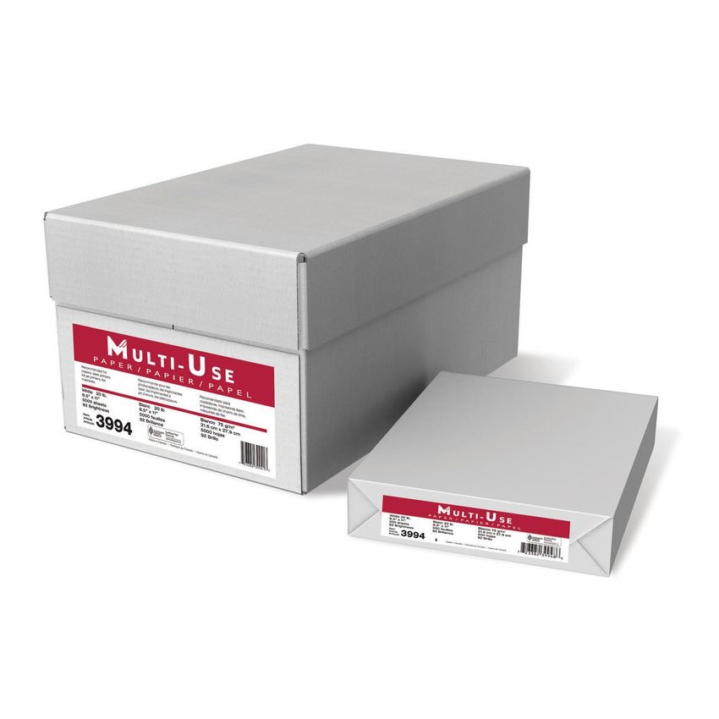


plan procurement management tools & techniques (cont’d)
Matching Game
Source selection analysis
What approach will be taken to acquire/select the service/product supplier?
Least cost
Qualifications only
Quality-based/highest technical proposal score
Quality and cost-based
Sole source
Fixed budget
A.
E.
D.
F.
B.
A.
C.
B. Vaccine for new variation of pandemic virus
C. Hot tub
E. Office supplies
F. Design wastewater treatment plant for City of London
See Slide Notes
D. Paint two bedrooms
Notes:
There is a non-visible white rectangular graphic just to the left of the numbers 1 to 6. You can drag it down to reveal the answers one at a time.
Images:
https://www.denis.ca/en/catalogue/produit.html?I=79011&C=00
https://todayshomeowner.com/how-to-paint-a-room-like-a-pro/
Nacsworld.com
Hkpr.on.ca

Slide 23
Summary of our journey today
Use of inputs, tools, techniques in planning project procurement
Considerations for make-or-buy decision
Use of calculations in the make-or-buy decision
Source selection analysis

Slide 24
Homework and evaluations
Readings for next module as listed in Course Overview
Individual Assignment – Make-or-Buy Analysis

Slide 25
references
Project Management Institute (2017). A Guide to the Project Management Body of Knowledge (Sixth Edition).
Kerzner, Harold (2017). Project Management, Twelfth Edition.
Watts, A. (2014). Project Management. Victoria, B.C.:BCcampus. Retrieved from https://opentextbc.ca/projectmanagement/.

